Slide 1
Software Design for Cloud 2
Python Programming
Lecture 3
Methods

Slide 2
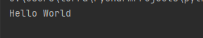
Functions
def main():
# Simple Method
message()
def message():
print('Hello World')
main()

Slide 3
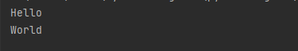
Functions
def main():
# Simple Method
display("Hello")
display("World")
def display(var):
print(var)
main()

Slide 4
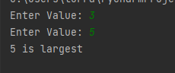
Functions return values
def main():
val1 = my_read()
val2 = my_read()
if (val1>val2):
my_print(val1)
else:
my_print(val2)
def my_read():
res = int(input('Enter Value: '))
return res
def my_print(value):
print('{0} is largest'.format(value))
main()

Slide 5
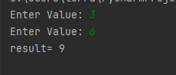
Functions 2 input parameters
def main():
val1 = int(input('Enter Value: '))
val2 = int(input('Enter Value: '))
result = add(val1, val2)
print('result= {0}'.format(result))
def add(x,y):
res = x + y
return res
main()

Slide 6
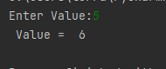
Global Variables: Shared By Methods Use sparingly Tight Coupling
value=0
def main():
global value
value = int(input('Enter Value:'))
increment()
print(' Value = {0} '.format(value))
def increment():
global value
value = value + 1
main()

Slide 7
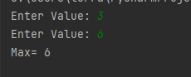
Ex31: Complete Max Method Use: Ex31_skel.py
def main():
val1 = int(input('Enter Value: '))
val2 = int(input('Enter Value: '))
result = max(val1, val2)
print('Max= {0}'.format(result))
main()

Slide 8
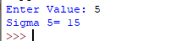
Use: Ex32_skel.py sigma(5)= 1 + 2 + 3 + 4 + 5= 15 Use: for value in range(1, x+1): result = result + value
Ex32: Complete Sigma Method
def main():
val1 = int(input('Enter Value: ‘))
result = sigma(val1)
print(‘Sigma {0} = {0}'.format(val1,result))
def sigma(x)
main()

Slide 9
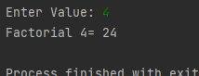
Use: Ex33_skel.py factorial(4)= 1 * 2 * 3 * 4 = 24 4! = 24
Ex33: Complete Factorial Method
def main():
val1 = int(input('Enter Value: ‘))
result = factorial(val1)
print(‘Factorial {0} = {0}'.format(val1,result))
def factorial(x)
main()

Slide 10
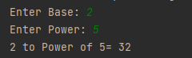
Use: Ex34_skel.py power(2,4)= 2 * 2 * 2 * 2 = 16 2⁴= 16
Ex34: Complete Power Method
def main():
base = int(input('Enter Base: '))
pow = int(input('Enter Power: '))
result = power(base, pow)
print('{0} to Power of {1}= {2}'.format(base, pow, result))
def power(b,p):
main()

Slide 11
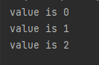
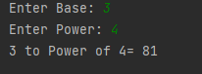
count=0 # step 1 while (count <3): # step 2 print('value is {0}'.format(count)) count= count + 1 # step 3
Ex35: Complete Power Method using while
Use: Ex35_skel.py
def main():
base = int(input('Enter Base: '))
pow = int(input('Enter Power: '))
result = power(base, pow)
print('{0} to Power of {1}= {2}'.format(base, pow, result))
def power(b,p):
main()

Slide 12
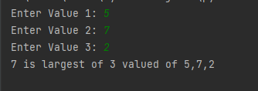
Ex36: Return max of 3 values
Use: Ex36_skel.py
def main():
value1 = int(input('Enter Value 1: '))
value2 = int(input('Enter Value 2: '))
value3 = int(input('Enter Value 3: '))
result = largest(value1,value2,value3)
print('{0} is largest of 3 valued of {1},{2},{3}'.format(result, value1, value2, value3))
def largest(v1,v2,v3):
main()

Slide 13
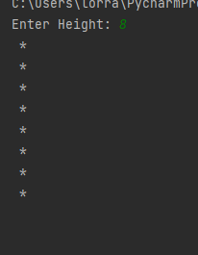
print(‘ *’) * print(‘ *’) *
Ex37: Print Vertical Line of *
Use: Ex37_skel.py
def main():
height = int(input('Enter Height: '))
display(height)
def display(height):
main()

Slide 14
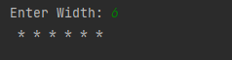
print(‘ *’, end=‘’) print(‘ *’, end=‘’) * * # prints on same line
Ex38: Print Horzintal Line of *
Use: Ex38_skel.py
def main():
width = int(input('Enter Width: '))
display(width)
def display(width):
main()

Slide 15
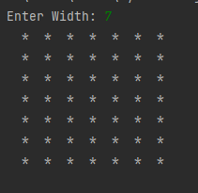
for val1 in range(1, width+1): for val2 in range(1,width+1):
Ex39: Print Squareof *
Use: Ex39_skel.py
def main():
width = int(input('Enter Width: '))
display(width)
def display(width):
main()

Slide 16
Extra Question
Table Radius Area
Celsius Fahrenheit

